Slide 1

TITLE

Slide 2
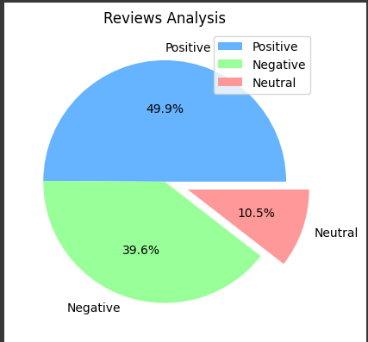

INSIGHTS FROM CUSOMER REVIEW
From cleaning 1000 reviews given by the customers, we obtained
Positive 499
Negative 396
Neutral 105

